Slide 1
CSE636: DevOps with AI Assistance
Fall, 2025
Qingsong Zhang, Ph. D.

Slide 2

Meet Your Professor
Academic Background
Ph. D. In Engineering, McGill University, Montreal, Canada
Mathematical model, Signal automation, Coding, Control
Language: Basic, Fortran, Cobol, Assembly, Pascal, C, C++, Java, SQL, MATLAB
System: MainFrame, 8086/80286/80386, PC, IBM, MAC, HPUX, SUN
Network: Novell, Token Ring, Ethernet, LAN, WAN, SD-WAN, PBX
Professional Expertise
Hewlett Packard, IT Specialist —> Software Release Manager
General Electric, Software Release Manager and Installer
Affymetrix, Software Development Manager
GE Digital, DevOps Manager, Cloud Infrastructure Staff
Walmart eCommerce, DevOps Director, Infra/QA/Support
PayPal, TPX (Technology, Platform and Technology) Director
Michaels, VP of Technology, Infra, Operation (SRE) and Big Data
PayPal, Principal Architect, SRE, Observability, Telemetry, AI Agent, MCP
Teaching
Northeast Polytechnic University (SFBU), 15+ years, Unix, Network, Oracle, QA, DevOps (Agile)
California Science and Technology University (CSTU), 2+ years, ChatGPT, DevOps+AI

Slide 3

01
Lecturer: Qingsong Zhang
TA: Van Lam
Course Information
02
E-mail: qingsong.zhang@cstu.edu
van.lam@cstu.edu
03
Time: Wed 7:30–9:00pm (Online),
Sat 9:00–10:30am (Onsite)
04
Length: 23 Hours | Credit: 1.5 Units
05
Office Hours: By Appointment Review Date: 11/4/2025

Slide 4

Grading Components
Grading Scale
98–100%: A+
93–97%: A
90–92%: A-
88–89%: B+
83–87%: B
80–82%: B-
78–79%: C+
73–77%: C
70–72%: C-
68–69%: D+
63–67%: D
60–62%: D-
Below 60%: F
- Mid-term Exam: 15%
- Project: 20%
- Case Discussions: 30%
- Final Exam: 20%
- Class Participation: 15%
**Total: 100%**

Slide 5
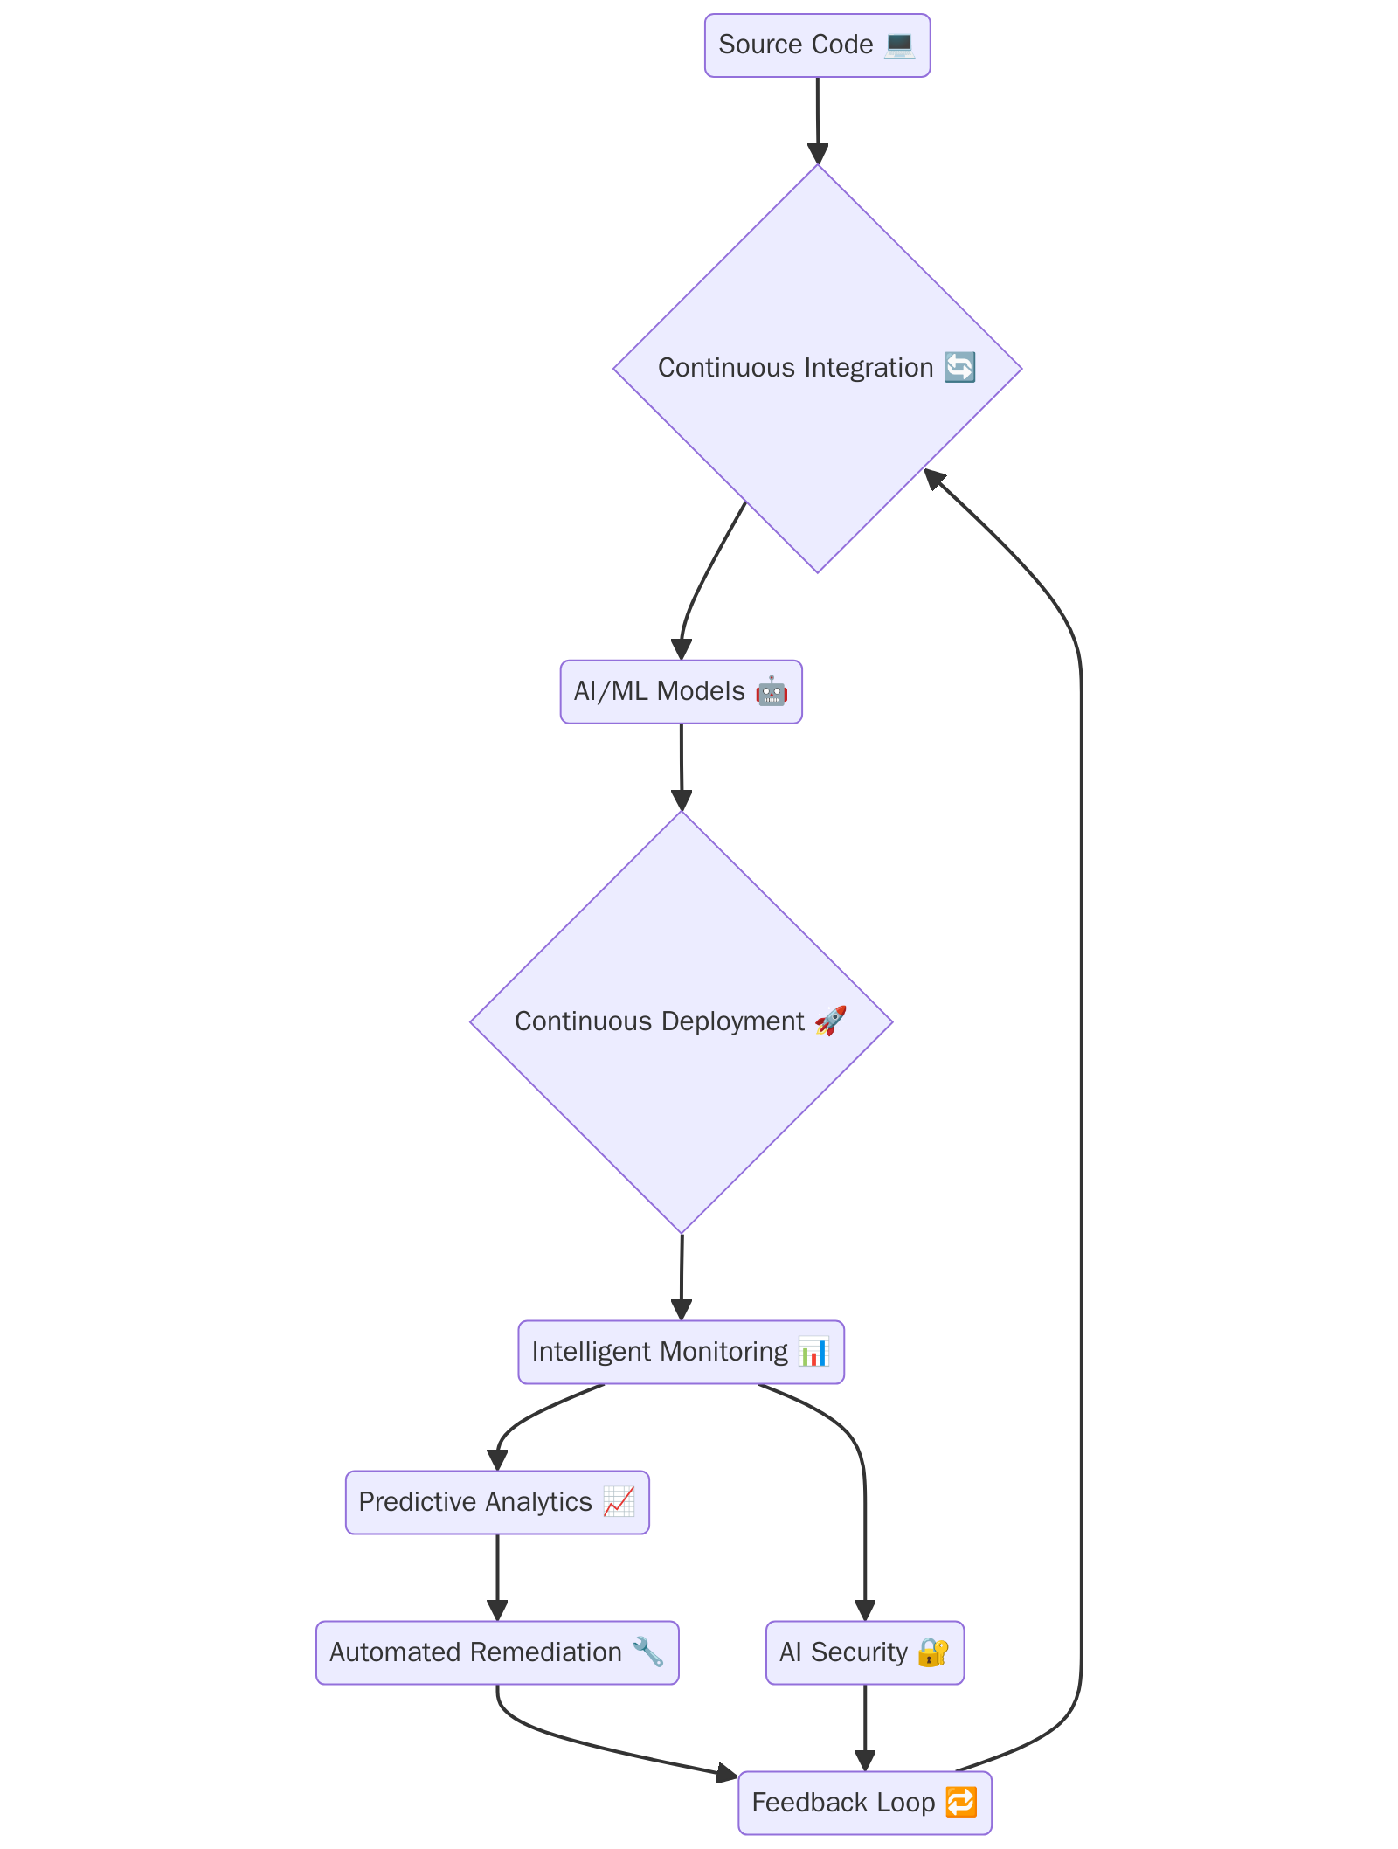

Course Summary: DevOps with AI
Course Overview
This 1.5-unit course explores how AI and ML can be integrated into DevOps practices to automate, optimize, and enhance software development and operations.
Practical Experience
Students will gain hands-on experience with AI-assisted CI/CD pipelines, predictive analytics, intelligent monitoring, automated remediation, and security.
Learning Outcomes
By the end of the course, students will:
Understand AI in DevOps,
Implement AI-driven automation,
Apply predictive analytics,
Use AI for monitoring and response,
Evaluate AI frameworks at scale.

Slide 6
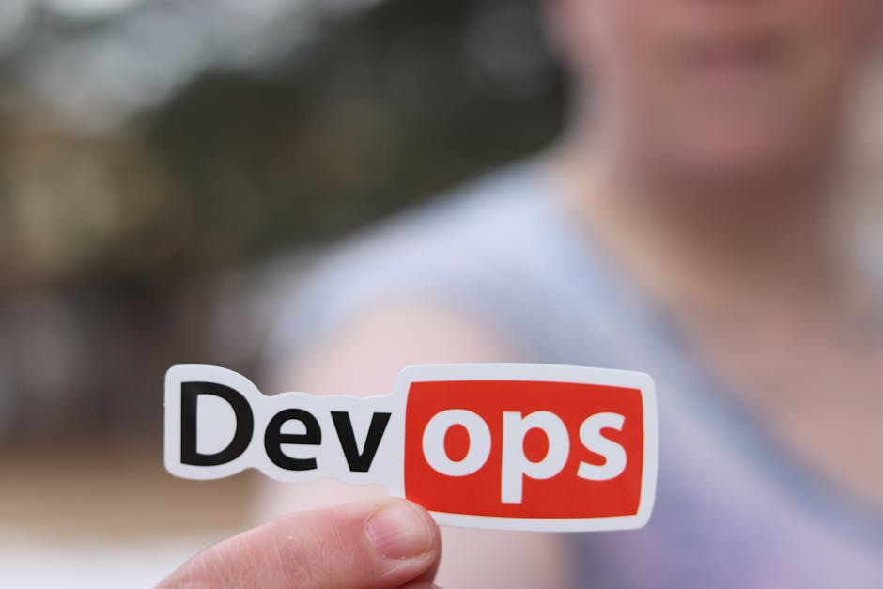
01
1. Evolution of DevOps and need for AI
Session Overview: What You'll Learn
02
2. Key DevOps challenges today
03
3. AI vs traditional automation
04
4. AIOps and practical use cases
05
5. Industry trends and case studies

Slide 7

What is DevOps?
Origins and Philosophy
DevOps emerged to bridge the gap between software development and IT operations, emphasizing collaboration, automation, and continuous delivery.
Key Practices
Core practices include CI/CD, infrastructure as code, monitoring, and rapid feedback loops—all aimed at streamlining software delivery.
Why It Matters
DevOps accelerates innovation and reduces time-to-market, making it essential in today's fast-paced tech world.

Slide 8
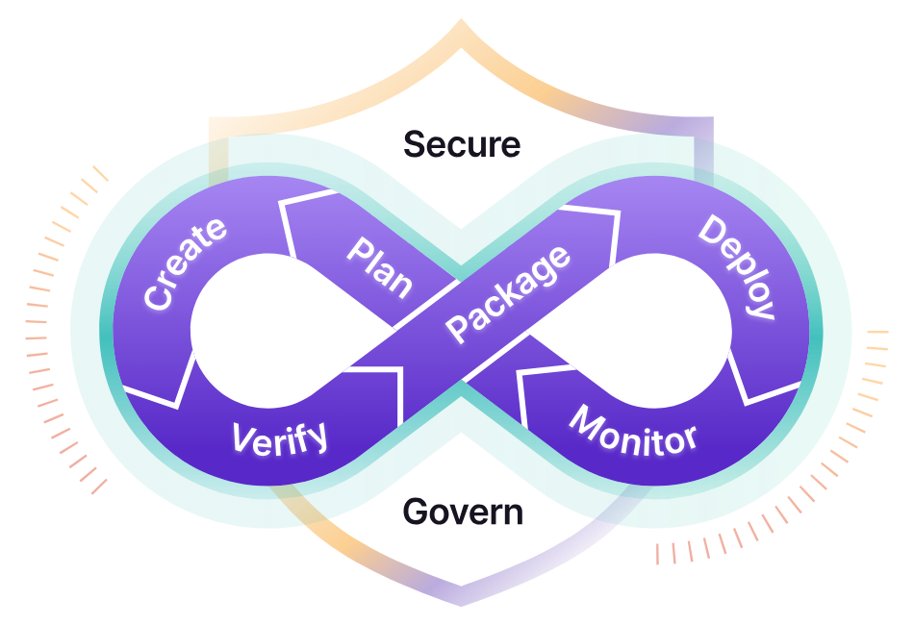
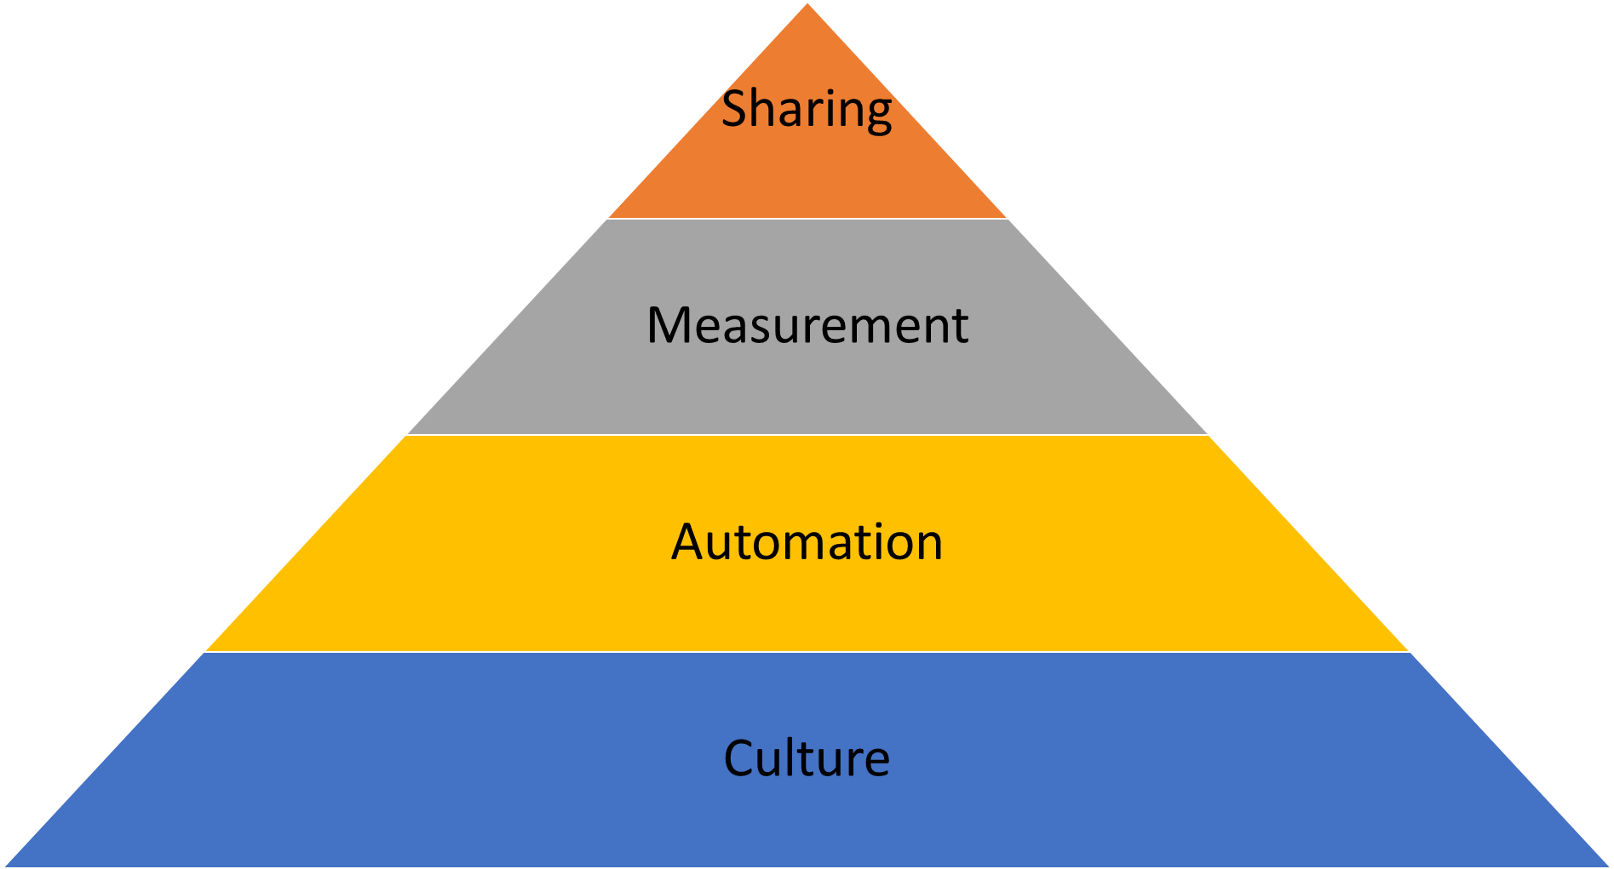
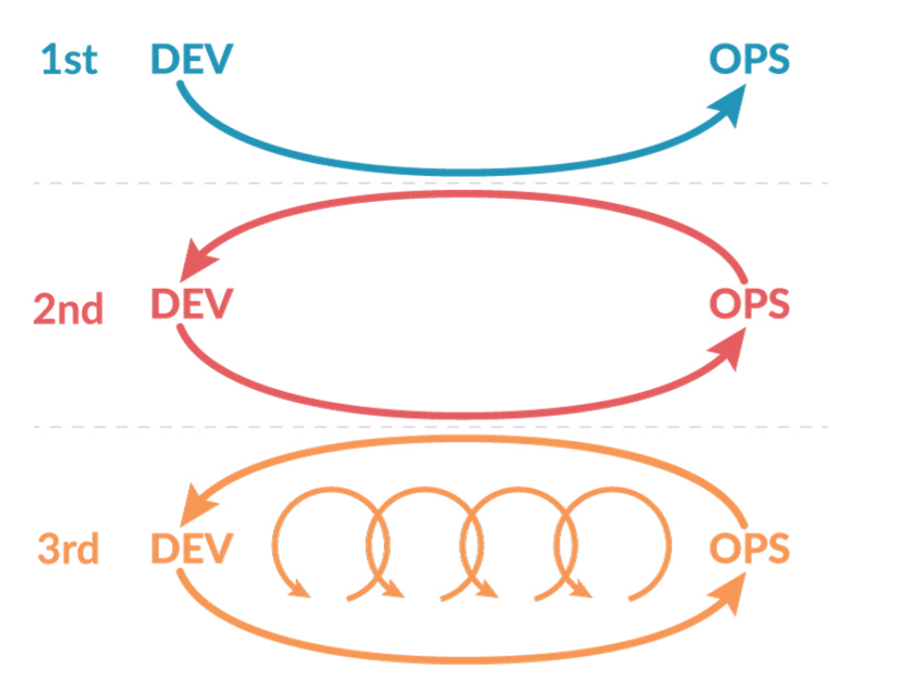
What is DevOps?
The practice of operations and development engineers working together through the entire service lifecycle, from the design and development process all the way to production support including the applications and systems.
DevOps
CAMS Model
Culture, Automation, Measurement and Sharing
Systems thinking and the principles of flow
Amplifying feedback loops
A culture of continuous experimentation and learning
Principles: The Three Ways

Slide 9

Rise of AI in Software Engineering
AI Enters DevOps
Artificial Intelligence has gradually moved into the DevOps lifecycle, particularly in testing, monitoring, and issue resolution.
Drivers of Adoption
Rising system complexity, data volume, and expectations for uptime have made AI integration increasingly attractive.
Impact on Engineering
AI tools help reduce manual tasks, improve decision-making, and detect issues earlier in the development process.

Slide 10

Why AI is a Game-Changer for DevOps
From Automation to Intelligence
AI elevates DevOps beyond rule-based automation by enabling systems to learn and adapt. This allows for smarter decision-making and proactive incident management.
Enhanced Speed and Reliability
AI reduces human errors and speeds up deployment cycles by predicting issues before they happen. It brings consistency and efficiency across environments.
AI tools analyze massive amounts of data in real-time, helping teams scale DevOps practices without losing visibility or control.
Scalability with Insight

Slide 11
Why AI + DevOps?
Complexity at Scale
Modern systems generate enormous amounts of telemetry data, making manual monitoring and response increasingly impractical.
Speed Expectations
Organizations demand faster deployments and minimal downtime, which requires intelligent automation to maintain reliability.
Adaptive Learning
AI can analyze historical patterns to predict future issues, proactively helping teams before problems impact users.

Slide 12
AI Across the DevOps Lifecycle
From Automation to Intelligence
AI elevates DevOps beyond rule-based automation by enabling systems to learn and adapt. This allows for smarter decision-making and proactive incident management.
Enhanced Speed and Reliability
AI reduces human errors and speeds up deployment cycles by predicting issues before they happen. It brings consistency and efficiency across environments.
AI tools analyze massive amounts of data in real-time, helping teams scale DevOps practices without losing visibility or control.
Scalability with Insight

Slide 13

AI Across the DevOps Lifecycle
AI enhances code reviews, suggests improvements, and predicts bugs early in the pipeline, improving code quality before deployment.
Code & Build
Machine learning models optimize test case selection and deployment strategies, minimizing downtime and failures.
Test & Deploy
Real-time anomaly detection and predictive analytics enable proactive issue resolution and smart alerting systems.
Monitor & Operate

Slide 14

Benefits of AI in DevOps
AI can automate repetitive processes and decision points, helping teams push changes to production more frequently and safely.
Faster Deployments
With real-time monitoring and learning-based alerting, systems can react to problems before they affect users.
Improved Stability
AI-driven insights guide teams on how to optimize cloud usage, manage pipelines, and allocate developer attention effectively.
Smarter Resource Allocation

Slide 15

Challenges of Integrating AI in DevOps
Data Quality and Availability
Effective AI models need high-quality, labeled data, which may be hard to obtain or organize in DevOps environments.
Model Transparency
DevOps teams may face trust issues due to the black-box nature of some AI algorithms, especially in critical systems.
Skill Gap and Tooling
Bringing AI into DevOps workflows requires new skillsets, proper integration tools, and cultural readiness across teams.

Slide 16
Challenges of Integrating AI in DevOps
Data Quality and Availability
Effective AI models need high-quality, labeled data, which may be hard to obtain or organize in DevOps environments.
Model Transparency
DevOps teams may face trust issues due to the black-box nature of some AI algorithms, especially in critical systems.
Skill Gap and Tooling
Bringing AI into DevOps workflows requires new skillsets, proper integration tools, and cultural readiness across teams.

Slide 17
Scalability Challenges in DevOps
Growing Infrastructure
Modern architectures like microservices and containers increase the complexity of managing environments at scale.
Human Limitation
Manual oversight struggles to keep up with real-time monitoring and dynamic scaling requirements.
AI to the Rescue
AI assists by automating responses and detecting patterns across massive datasets.

Slide 18

Monitoring and Incident Response
Traditional Monitoring
Relies heavily on pre-defined rules and manual analysis, which often leads to alert fatigue.
Challenges in Incident Triage
Teams face delays in identifying root causes and prioritizing the right issues to fix.
AI-Augmented Solutions
Machine learning models detect anomalies early, group related alerts, and recommend fixes.

Slide 19
Toolchain Complexity in DevOps
Too Many Tools
Modern DevOps stacks include a mix of CI/CD, monitoring, infrastructure, and collaboration tools.
Integration Fatigue
Connecting and managing toolchains requires effort and introduces potential failure points.
AI Integration Advantage
AI can unify and make sense of data from across the toolchain, enhancing decision-making.

Slide 20

Traditional Automation in DevOps
Scripted Workflows
Classic DevOps automation relies on scripts and tools configured for specific tasks like deployment or testing.
Benefits
It increases speed and reduces manual error but lacks adaptability.
Limitations
Static rules can't handle unexpected events, making them reactive rather than proactive.

Slide 21

AI-Driven DevOps
Proactive Intelligence
AI can analyze patterns, predict incidents, and recommend preventive actions before users are impacted.
Smart Decision-Making
Machine learning models help prioritize alerts, assign tasks, and optimize workflows in real-time.
Key Difference
Unlike static automation, AI evolves and adapts over time, improving efficiency and reliability.

Slide 22

Understanding AIOps
Definition
AIOps stands for Artificial Intelligence for IT Operations, combining big data and ML to automate and enhance operations.
Core Functions
AIOps platforms ingest logs, metrics, and events to detect anomalies, correlate incidents, and trigger responses.
Value Proposition
It reduces mean time to resolution (MTTR) and improves service reliability.

Slide 23

AI Use Case: Anomaly Detection
What It Does
Automatically identifies deviations from normal behavior in logs, metrics, and performance data.
Why It Matters
Early detection helps prevent outages and performance degradation.
Student Perspective
Visualize how your future monitoring tools might detect a server issue before it affects users.

Slide 24

AI Use Case: Resource Optimization
Dynamic Scaling
AI helps adjust compute and storage resources based on real-time usage patterns.
Cost Efficiency
Smart resource allocation avoids over-provisioning, cutting unnecessary costs.
Example
A system detects low traffic periods and automatically scales down infrastructure without service impact.

Slide 25
AI Use Case: Incident Triage
Alert Overload
DevOps teams face too many alerts, many of which are false positives or low priority.
AI Filtering
AI clusters alerts by root cause and urgency, allowing teams to focus on real issues first.
Student Takeaway
Imagine being able to focus only on problems that truly matter—AI makes that possible in high-noise environments.

Slide 26

Case Study: Netflix AIOps
The Challenge
Managing a vast microservices ecosystem and minimizing user-facing issues in real time.
The Solution
Netflix uses AI to analyze metrics and logs, detect anomalies, and route incidents automatically.
The Outcome
Improved uptime, faster resolution, and better user experience at scale.

Slide 27
AI Tooling Landscape (2025)
Monitoring & Observability
Tools like Dynatrace, DataDog, and New Relic are integrating more AI features for alert reduction and root-cause analysis.
CI/CD & Deployment
GitHub Copilot, Harness, and others provide AI-driven code suggestions and deployment strategies.
Trends to Watch
Consolidation of platforms, low-code AIOps, and open-source innovation are shaping the future of AI in DevOps.

Slide 28
What is Generative AI?
Generative AI refers to models that can produce new content—like code, text, or images—based on training data and patterns.
Creating, Not Just Analyzing
Why It Matters in DevOps
DevOps teams can use generative AI to generate config files, deployment scripts, or documentation, saving time and improving quality.
Common Examples
Tools like ChatGPT and GitHub Copilot showcase how generative AI can support day-to-day developer and ops work.

Slide 29
What is Generative AI?
Generative AI refers to models that can produce new content—like code, text, or images—based on training data and patterns.
Creating, Not Just Analyzing
Why It Matters in DevOps
DevOps teams can use generative AI to generate config files, deployment scripts, or documentation, saving time and improving quality.
Common Examples
Tools like ChatGPT and GitHub Copilot showcase how generative AI can support day-to-day developer and ops work.

Slide 30
LLMs: Large Language Models in DevOps
LLMs are powerful AI systems trained on massive text datasets that understand and generate human-like language.
What is an LLM?
They assist in writing shell scripts, analyzing logs, generating YAML files, and answering complex DevOps queries quickly.
Use in DevOps
Without diving into neural network theory, LLMs work like smart assistants—ready to solve real-world DevOps problems.
No Theory, Just Use

Slide 31
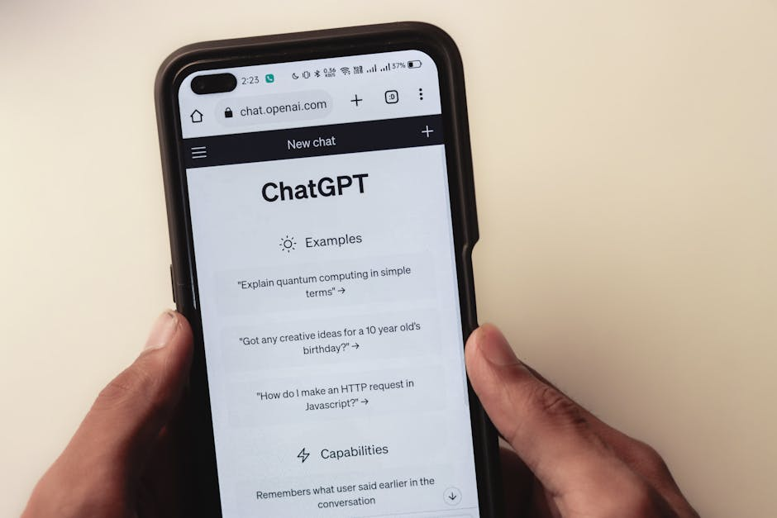
Prompt Engineering Basics
A prompt is the input you give an AI model to get the desired output, like 'Write a bash script for CPU monitoring'.
What is a Prompt?
Be specific, include context, and define format to get accurate responses from LLMs.
Crafting Effective Prompts
From CI/CD pipelines to infrastructure provisioning, prompts can drive AI to generate useful artifacts instantly.
DevOps Use Cases

Slide 32

Traditional Automation vs AI-Driven
Rule-Based vs Intelligent
Traditional DevOps automation relies on predefined rules. AI can adapt and learn from new data, making decisions without explicit instructions.
Static Scripts vs Dynamic Generation
AI enables dynamic creation of scripts and configurations tailored to real-time inputs and context.
AI systems detect anomalies and recommend or execute recovery actions autonomously, reducing downtime and human effort.
Error Handling & Recovery

Slide 33

GitHub Copilot
AI-Powered Code Assistant
GitHub Copilot suggests whole lines or blocks of code as you type, trained on public codebases, including shell and infra scripts.
DevOps Use Cases
Copilot helps with writing CI/CD scripts, Dockerfiles, and configuration management in YAML or JSON.
Accelerates development, but results should be reviewed for accuracy and security, especially in ops code.
Pros & Watch-outs

Slide 34

Amazon CodeWhisperer
Amazon CodeWhisperer is an AI coding companion that provides real-time code recommendations tailored to AWS services.
Developer-Focused AI Suggestions
Supports languages like Python, Bash, and JavaScript—useful for scripting automation and managing infrastructure.
DevOps-Relevant Features
Offers integrations with AWS IAM, logging, and enterprise-grade security for DevOps workflows.
Enterprise Ready

Slide 35
OpenAI API
Flexible LLM Capabilities
OpenAI's GPT-based API allows DevOps teams to integrate intelligent chat, document generation, and scripting assistance into tools.
DevOps Integration
Useful for log summarization, YAML generation, and explaining error messages in plain English.
While powerful, API usage should include safety guards, token limits, and audit trails in DevOps environments.
Use Responsibly

Slide 36

Ansible + AI Integrations
Ansible modules can be extended with AI to predict deployment issues, validate playbooks, and generate templated configs.
Smart Configuration Management
AI can audit or suggest improvements in playbooks based on past runbooks and common patterns.
Intelligent Playbook Reviews
AI tools can read Ansible logs and recommend fixes for failed runs automatically.
Faster Remediation

Slide 37

Kubernetes with AI Monitoring
Complex System, Smarter Monitoring
AI-enhanced monitoring solutions can detect issues in Kubernetes clusters before they escalate by analyzing logs, metrics, and trends.
Machine learning models help trace performance issues to their source faster than traditional dashboards.
Root Cause Analysis
Predictive scaling uses AI to allocate or remove resources proactively based on usage patterns.
Better Scaling Decisions

Slide 38
Summary: Popular AI Tools for DevOps
GitHub Copilot – Code generation and suggestions
Amazon CodeWhisperer – AWS-optimized coding assistant
OpenAI API – Flexible LLM integration for custom workflows
Ansible + AI – Smarter playbook validation and automation
Kubernetes AI Tools – Predictive monitoring and scaling

Slide 39
Student Reflection
How ready is your DevOps pipeline for AI?
Looking Ahead: Your Role in AI + DevOps
As future engineers, you will shape how AI transforms DevOps. Think critically about automation, ethics, and innovation. Ask yourself how you would approach integrating AI into your own workflows.

Slide 40

Hands-On Project: VM Health Checker
What You'll Build
A bash script that checks key system parameters—CPU usage, memory, and disk space—and reports health status.
Interactive Mode with 'explain'
The script accepts an 'explain' argument to provide a detailed, user-friendly summary of the VM's condition.
DevOps Impact
Automating health checks helps teams monitor system integrity and proactively detect issues before outages occur.

Slide 41

Step 1: GitHub Repository Setup
Create Your Repo
Start by creating a new GitHub repository named `vm-health-check`. Initialize it with a README and a `.gitignore` for shell scripts.
Folder Structure
Organize your files with a clear folder structure, e.g., `scripts/health_check.sh` and `docs/usage.md`.
Version Control
Commit changes regularly with meaningful messages to track script improvements.

Slide 42

Step 2: Script Structure Overview
Shell Script Entry Point
Create a `health_check.sh` file with a `main()` function. Use modular functions for CPU, memory, and disk checks.
Argument Parsing
Support `--explain` using a `case` block or `getopts` to trigger a verbose summary mode.
Execution Flow
Check parameters > run health checks > generate output > optionally display explanations.

Slide 43

Step 3: CPU Health Check
CPU Usage Monitoring
Use `top`, `mpstat`, or `/proc/stat` to gather CPU usage. For example: `top -bn1 | grep 'Cpu(s)'`.
Set Thresholds
Compare current usage against a defined threshold (e.g., 85%) to determine health status.
Script Snippet
Example: `if (( $(echo "$cpu > 85" | bc -l) )); then echo "High CPU usage"; fi`

Slide 44

Step 4: Memory Health Check
Capture Memory Usage
Use `free -m` to retrieve memory statistics and calculate usage: `used/total` * 100.
Set Safe Threshold
A usage over 90% might indicate memory pressure. Flag as 'Warning' or 'Critical' accordingly.
Script Snippet
Example: `mem_usage=$(free | awk '/Mem/ { printf("%.2f", $3/$2 * 100.0) }')`

Slide 45

Step 5: Disk Space Check
Gather Disk Usage
Use `df -h /` or `df --output=pcent / | tail -1` to get the root filesystem's usage percentage.
Threshold Alerts
Mark disks as unhealthy if usage exceeds, say, 80%. Show warnings in red or bold terminal output.
Script Snippet
disk_usage=$(df / | awk 'END { print $5 }' | sed 's/%//')

Slide 46

Step 6: Combine All Health Metrics
Unified Health Logic
Run all three checks—CPU, memory, and disk—and aggregate their results into a single status report.
Visual Output
Use colors and symbols (✓ / ⚠️ / ✗) to show system health per category.
Return Codes
Return specific exit codes (0: OK, 1: Warning, 2: Critical) to allow integration with cron or monitoring systems.

Slide 47

Step 7: Implement --explain Argument
Extended Output Mode
Add logic to detect `--explain` and display verbose descriptions for each metric's status.
Human-Friendly Language
Translate raw values into plain language. For example, 'CPU usage is above threshold. This may affect performance.'
Optional JSON or Markdown
Support output in structured formats for integration with monitoring tools or dashboards.

Slide 48

Step 8: Add Logging & Formatting
Log Important Events
Use `logger` or redirect output to a log file for tracking script execution and results.
Terminal Aesthetics
Use ANSI color codes for red (critical), yellow (warning), and green (healthy) statuses to improve readability.
Error Handling
Include fallback logic for missing tools or malformed inputs to make the script robust.

Slide 49

Step 9: Test Across VM Types
Run on Different Environments
Test the script on small, medium, and large VMs to ensure thresholds are realistic across contexts.
Validate --explain Output
Check if the extended output works as expected across varied loads and edge cases.
Automate Testing
Use cron jobs or CI pipelines to run and verify health checks periodically.

Slide 50

Step 10: Script Usage Examples
Basic Execution
Run `./health_check.sh` to print the current health status of the VM to the terminal.
Verbose Mode
Run `./health_check.sh --explain` to get detailed output explaining each metric and its implications.
Automated Monitoring
Integrate into cron with `*/15 * * * * /path/to/health_check.sh >> /var/log/vm_health.log`

Slide 51

Step 11: Automate Health Monitoring
Using Cron Jobs
Schedule the script to run periodically using `crontab -e` with your preferred timing interval.
Email Alerts
Use `mail` or `sendmail` to notify ops teams of unhealthy statuses directly from the script.
Integrate with Dashboards
Log results in a format consumable by Prometheus/Grafana or custom monitoring UIs.

Slide 52

Step 12: Walkthrough Demo
Demo Objectives
Show how the script runs, outputs statuses, and responds to `--explain`.
Recording or Live Run
Use screen recording or live terminal share to walk through setup, usage, and output.
Validation
Confirm script behavior under high CPU, low memory, or full disk scenarios.

